Slide 1









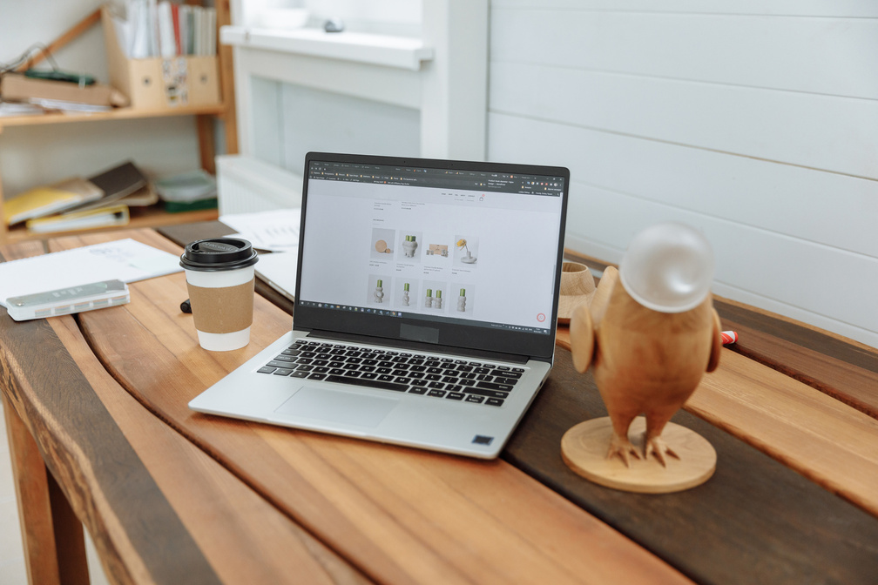
Welcome to
News Reporter
Website
E-PROJECT_TEAM1

Slide 2


Meet
Our Instructor
Mr. To Hoang Anh

Slide 3






TEAM MEMBERS
TRINH TUAN HIEP
NGUYEN MINH DUC
DUONG VAN HIEP
NGUYEN VIET ANH
TRAN DUC MINH
Team Leader
Team Member
Team Member
Team Member
Team Member

Slide 4

News Reporter Website
NEWS REPORTER IS NOT JUST A FORM OF ENTERTAINMENT BUT ALSO AN EXCELLENT WAY TO EXPAND KNOWLEDGE AND STAY INFORMED ABOUT THE LATEST DEVELOPMENTS ACROSS VARIOUS FIELDS IN SOCIETY. THE PRESS PLAYS A CRUCIAL ROLE IN INFORMING THE COMMUNITY, PROVIDING A MULTIFACETED VIEW OF THE WORLD AROUND US.

Slide 5




SOFTWARE
1
Visual Studio Code
2
XAMPP
3
MySQL
4
Git
FORK GIT

Slide 6

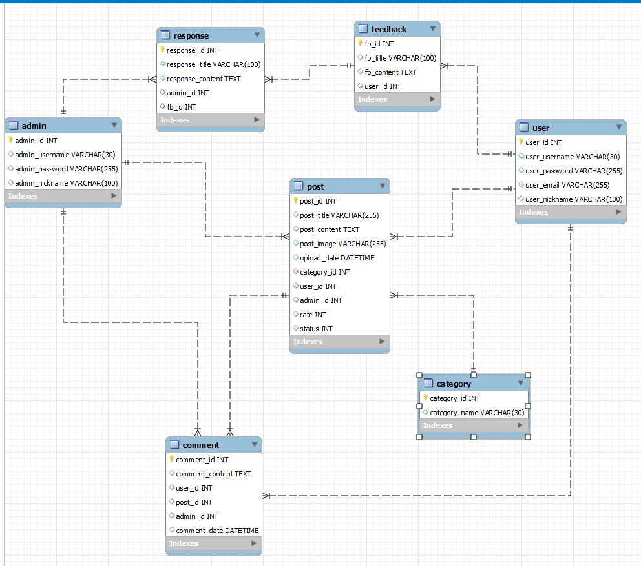
DATABASE
DESIGN

Slide 7
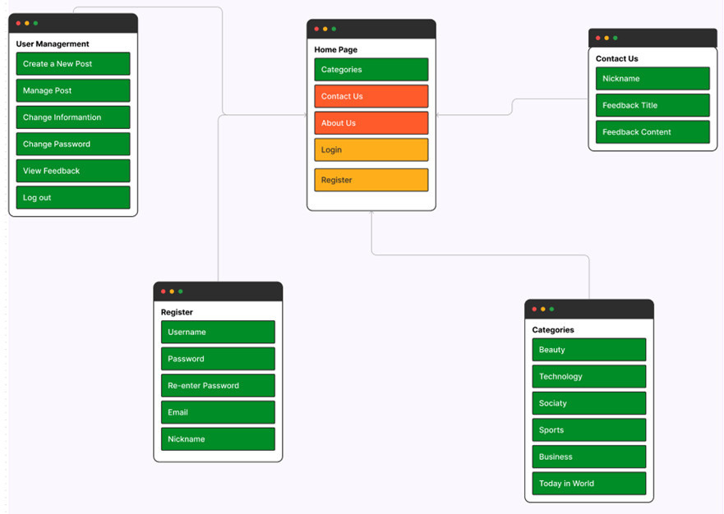
SITE MAP

Slide 8
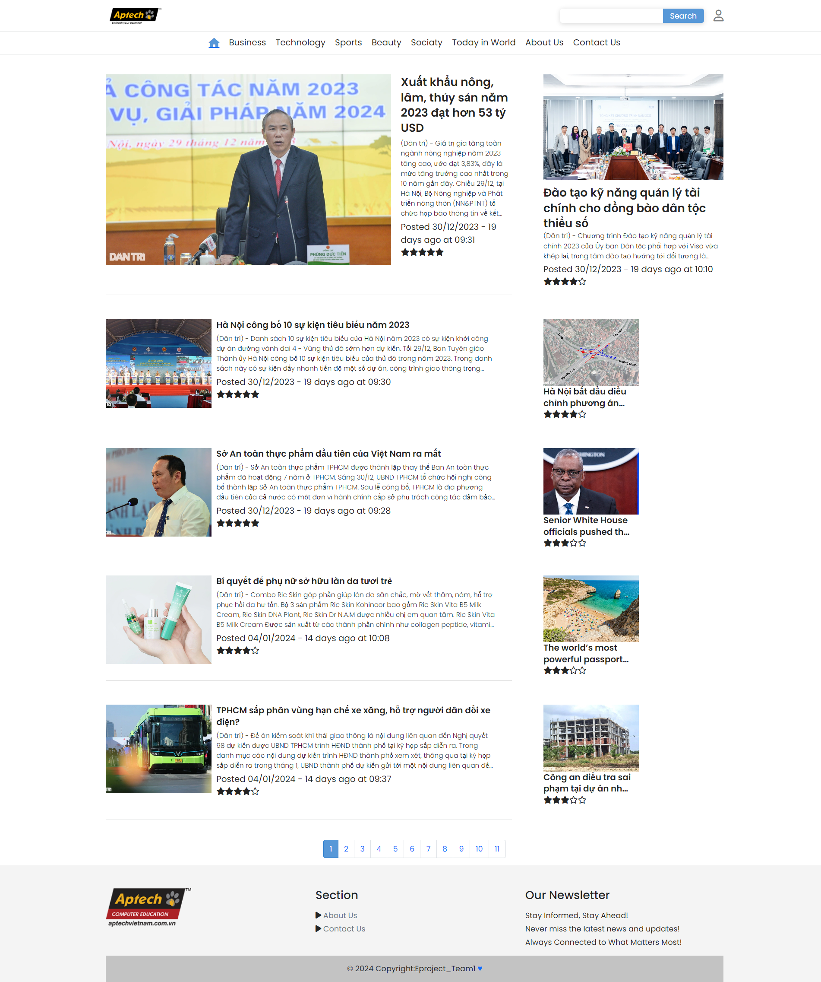
HOME PAGE
NEWS REPORTER
WEBSITE
INTERFACE
DESIGN

Slide 9
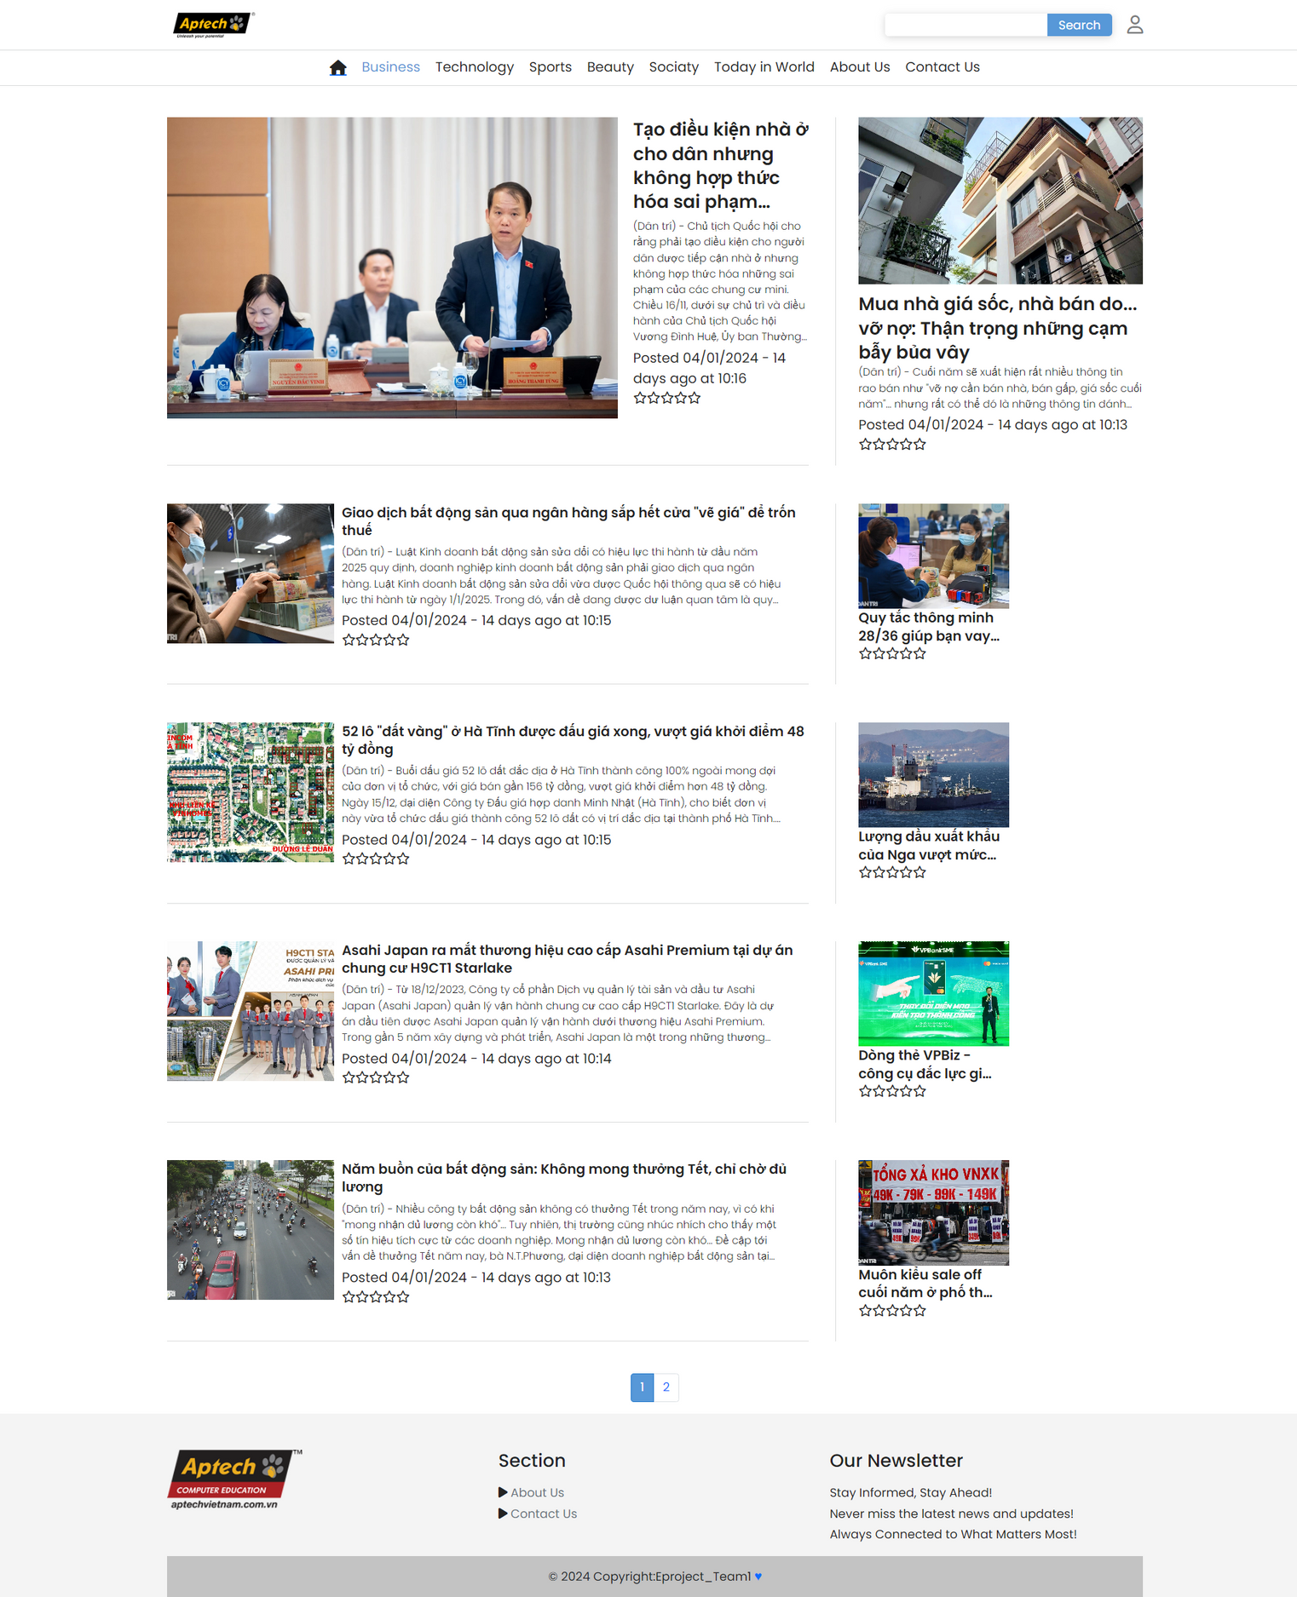
BUSINESS PAGE
NEWS REPORTER
WEBSITE
INTERFACE
DESIGN

Slide 10
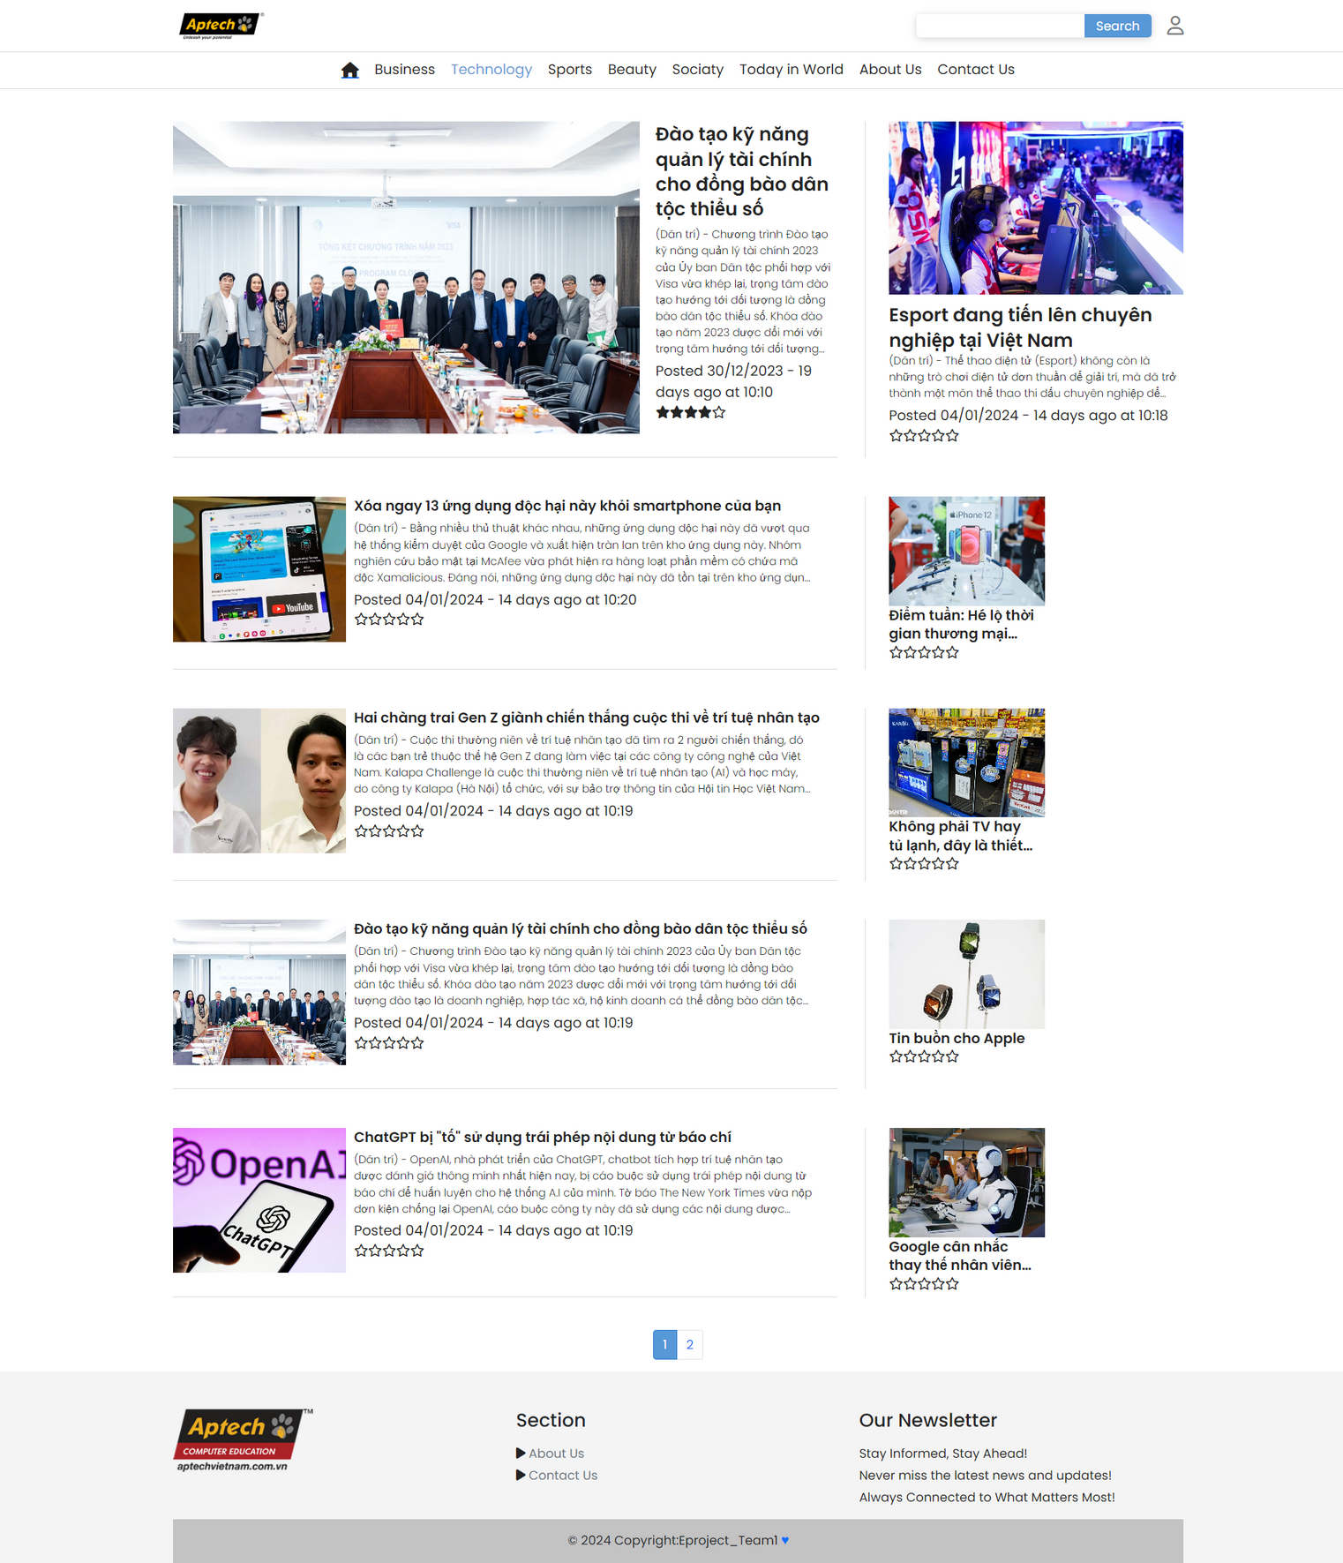
TECHLOGORY PAGE
NEWS REPORTER
WEBSITE
INTERFACE
DESIGN

Slide 11
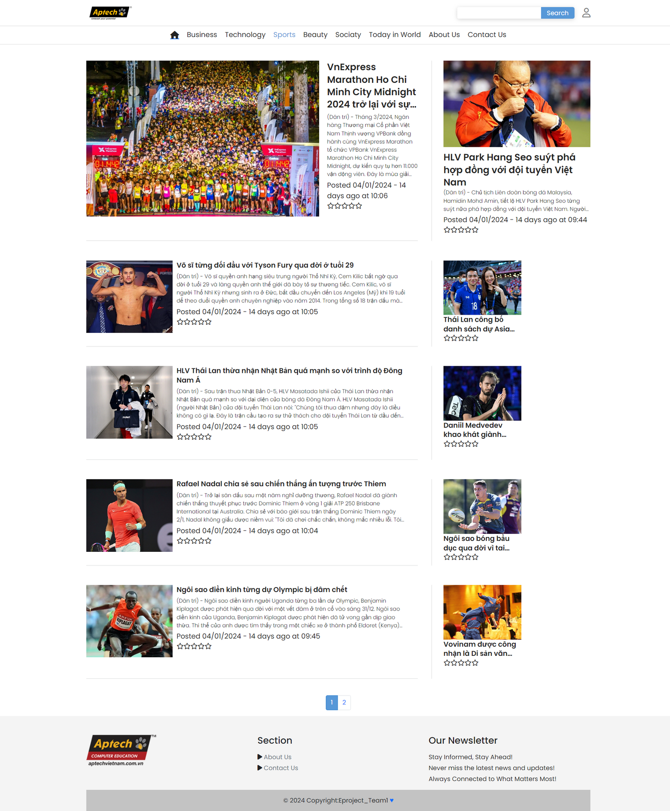
SPORTS PAGE
NEWS REPORTER
WEBSITE
INTERFACE
DESIGN

Slide 12
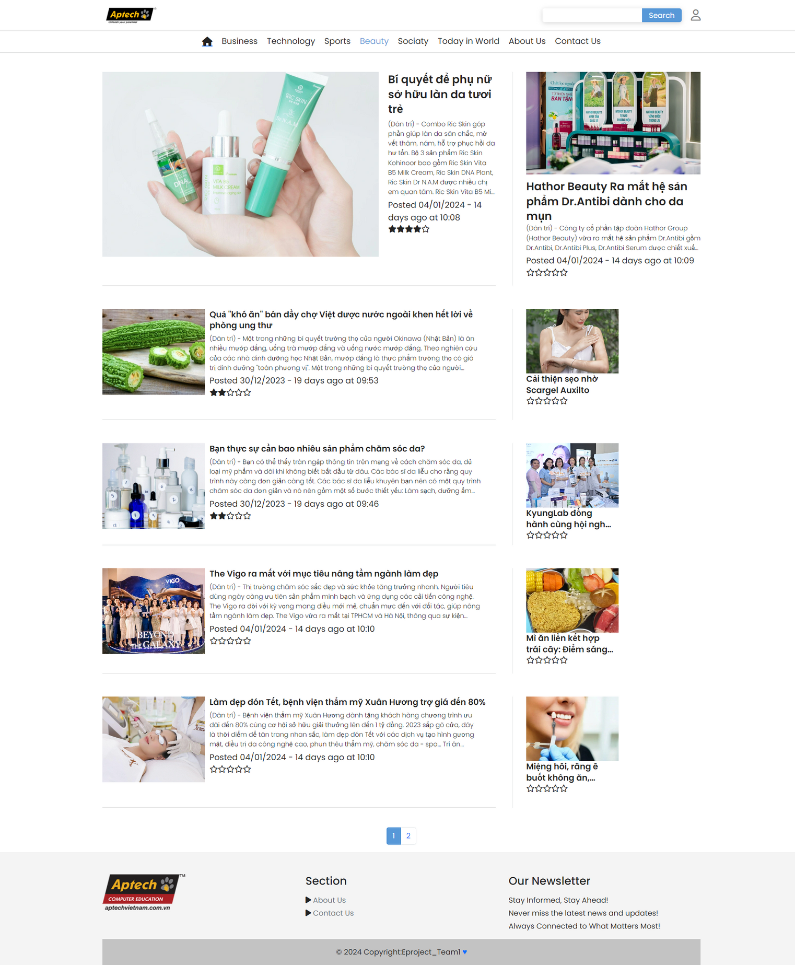
BEAUTY PAGE
NEWS REPORTER
WEBSITE
INTERFACE
DESIGN

Slide 13
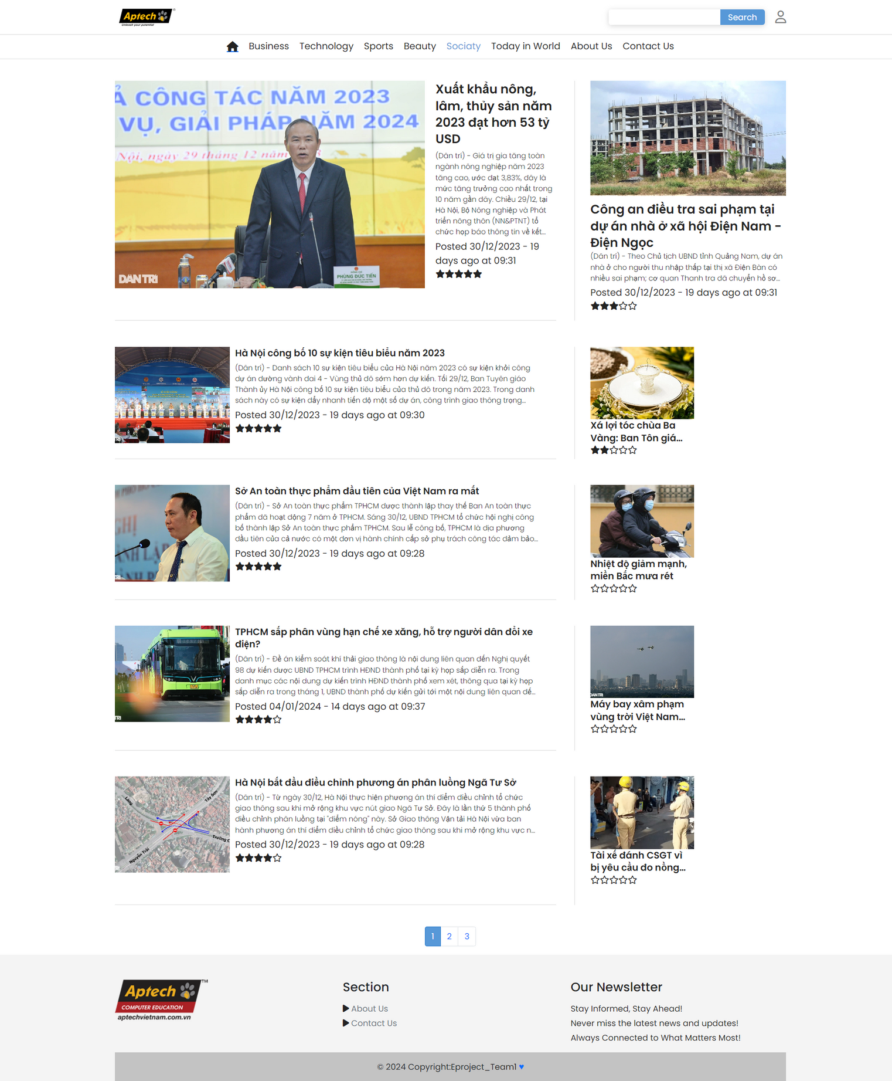
SOCIATY PAGE
NEWS REPORTER
WEBSITE
INTERFACE
DESIGN

Slide 14
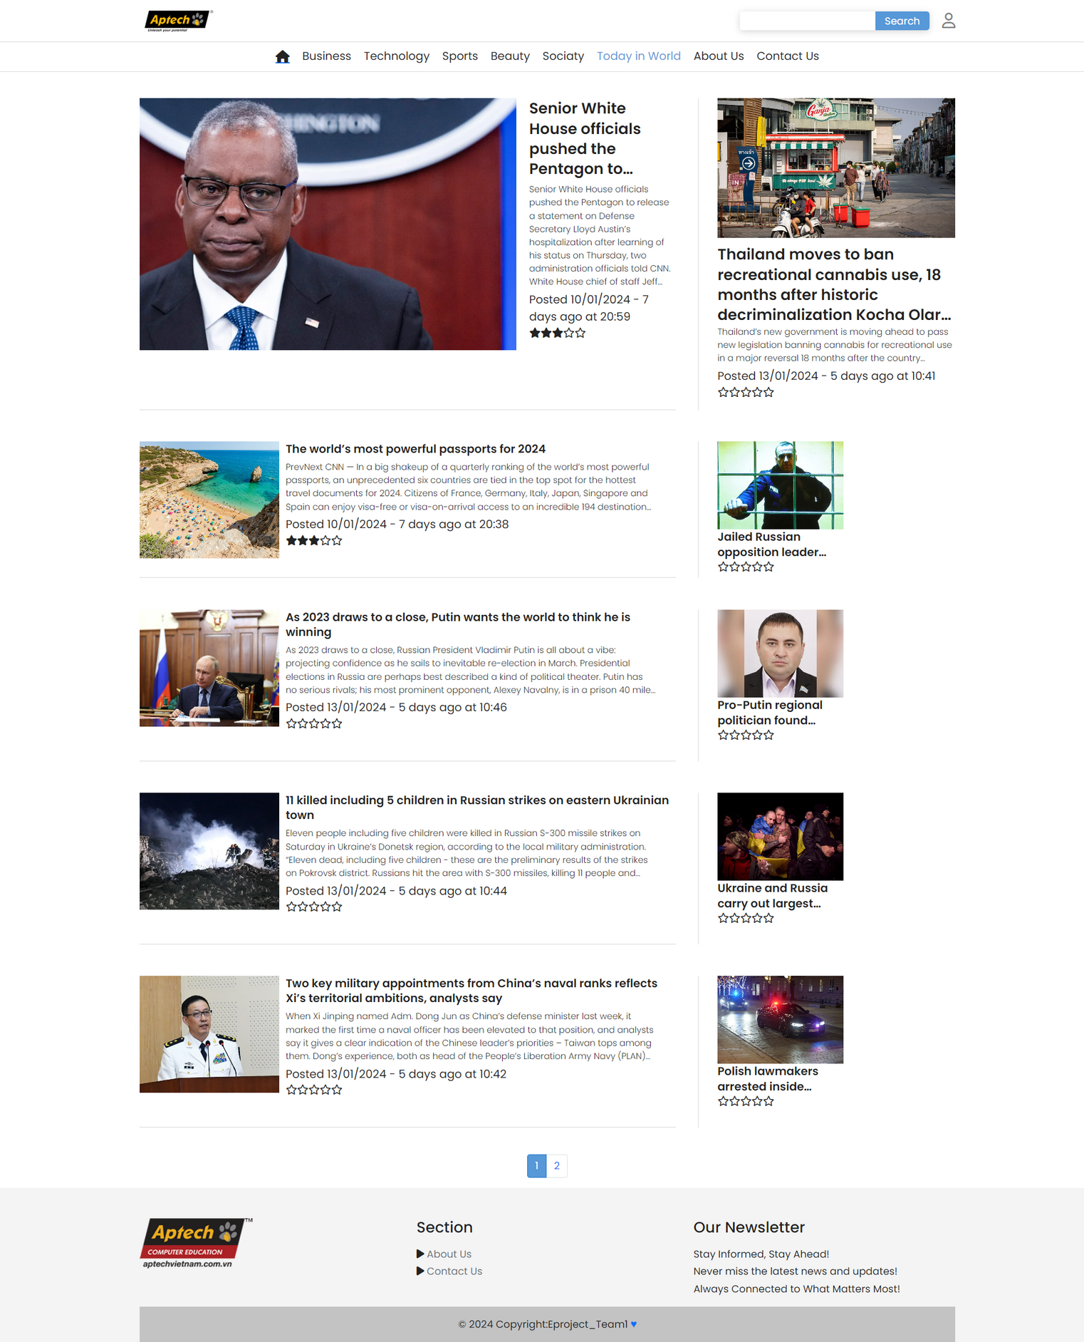
TODAY IN WORLD PAGE
NEWS REPORTER
WEBSITE
INTERFACE
DESIGN

Slide 15
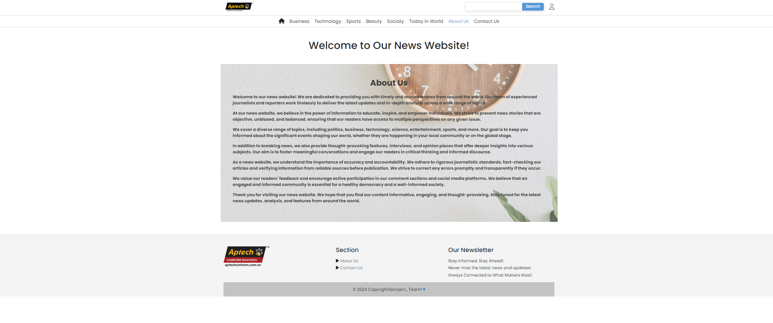
ABOUT US
NEWS REPORTER
WEBSITE
INTERFACE
DESIGN

Slide 16
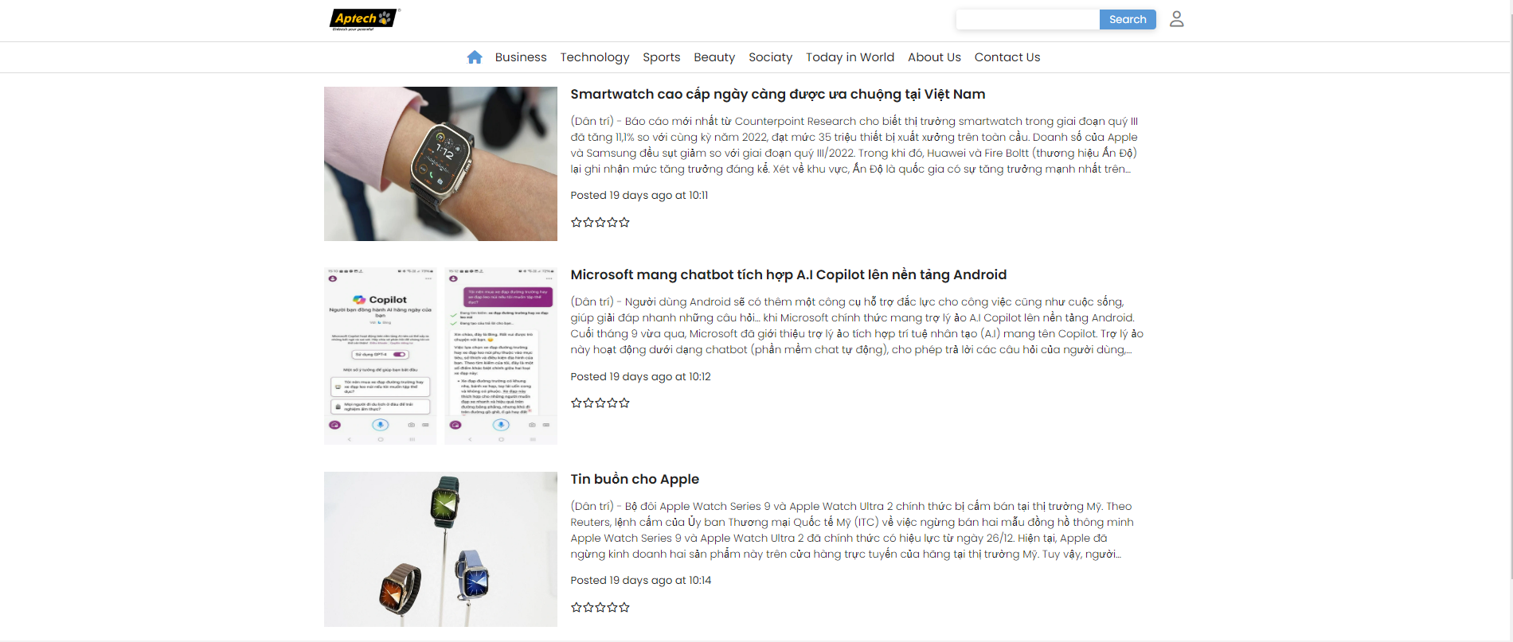
SEARCH PAGE
NEWS REPORTER
WEBSITE
INTERFACE
DESIGN

Slide 17
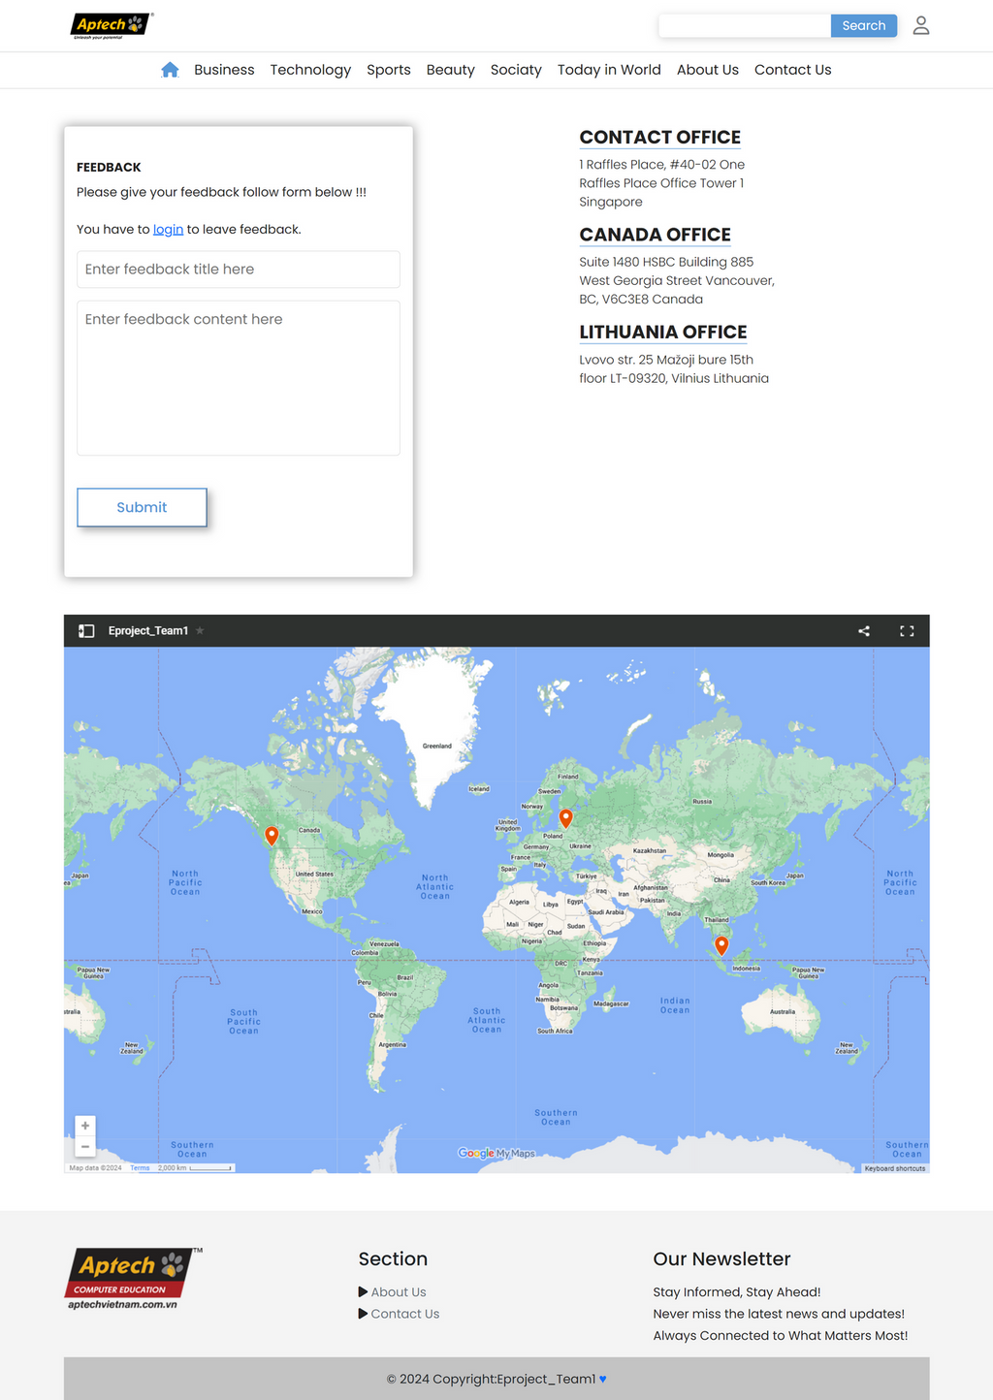
CONTACT US
NEWS REPORTER
WEBSITE
INTERFACE
DESIGN

Slide 18
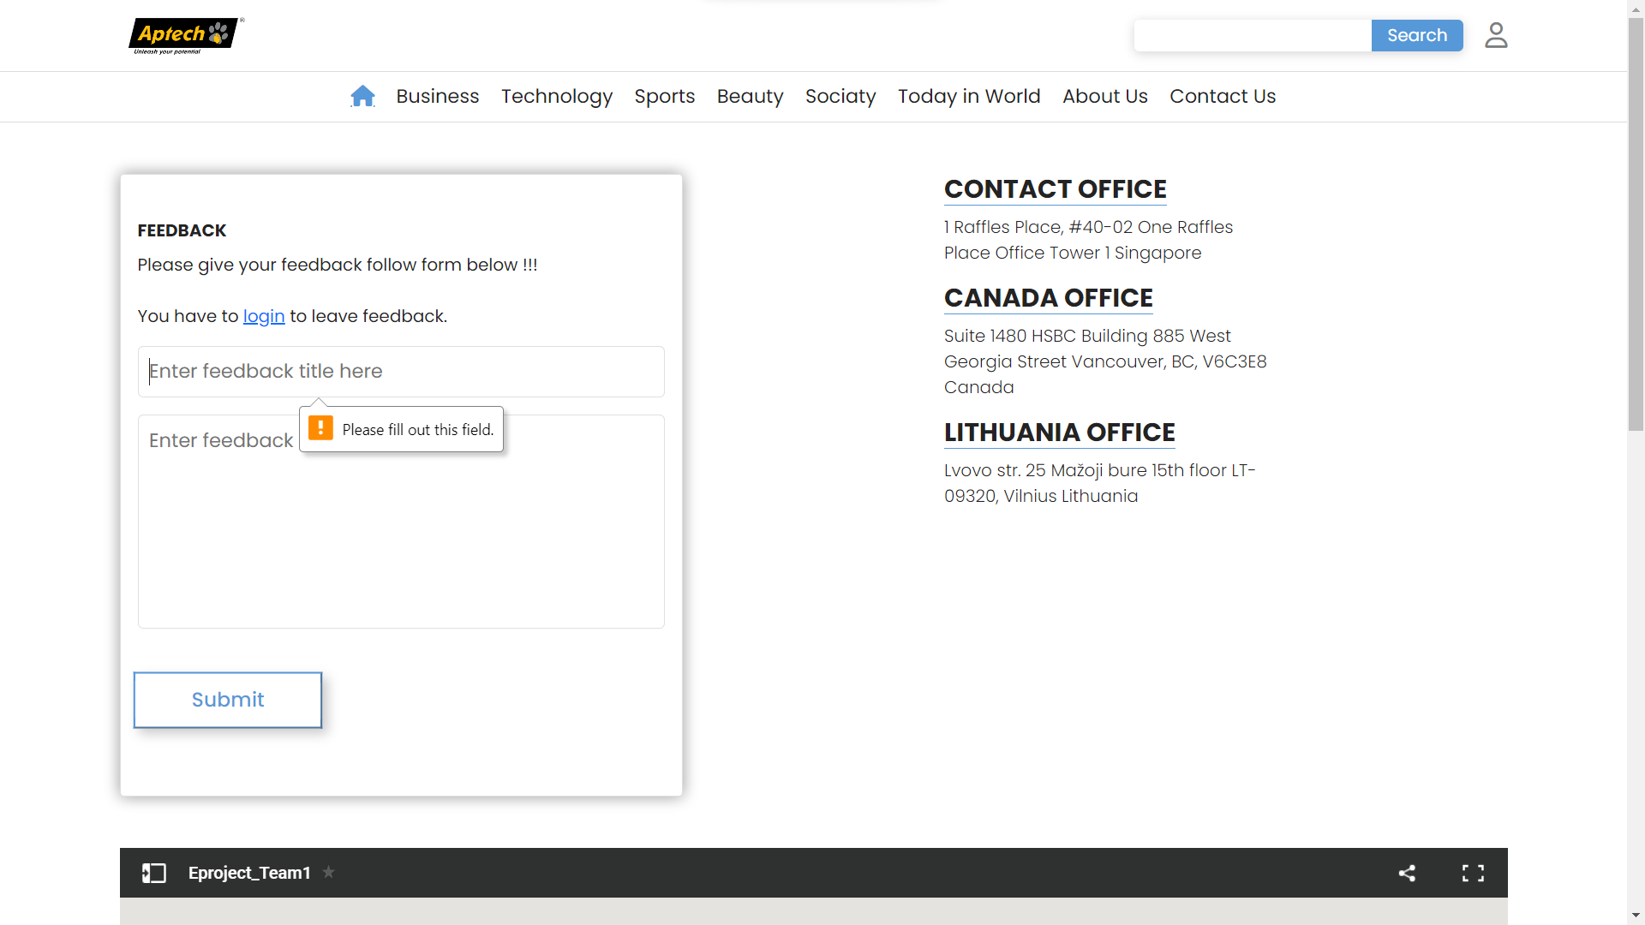
VIEW FEEBACK

Slide 19
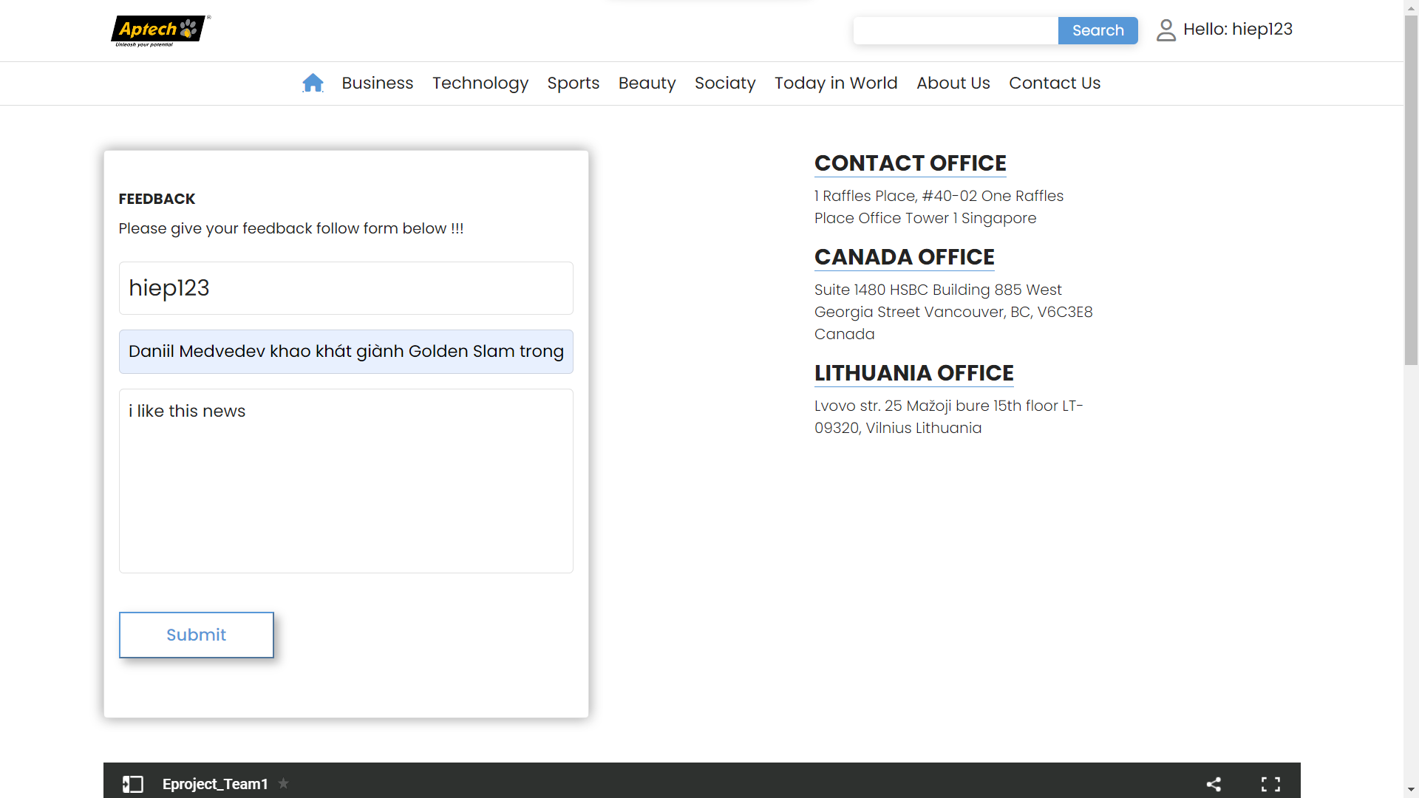

VIEW FEEDBACK

Slide 20
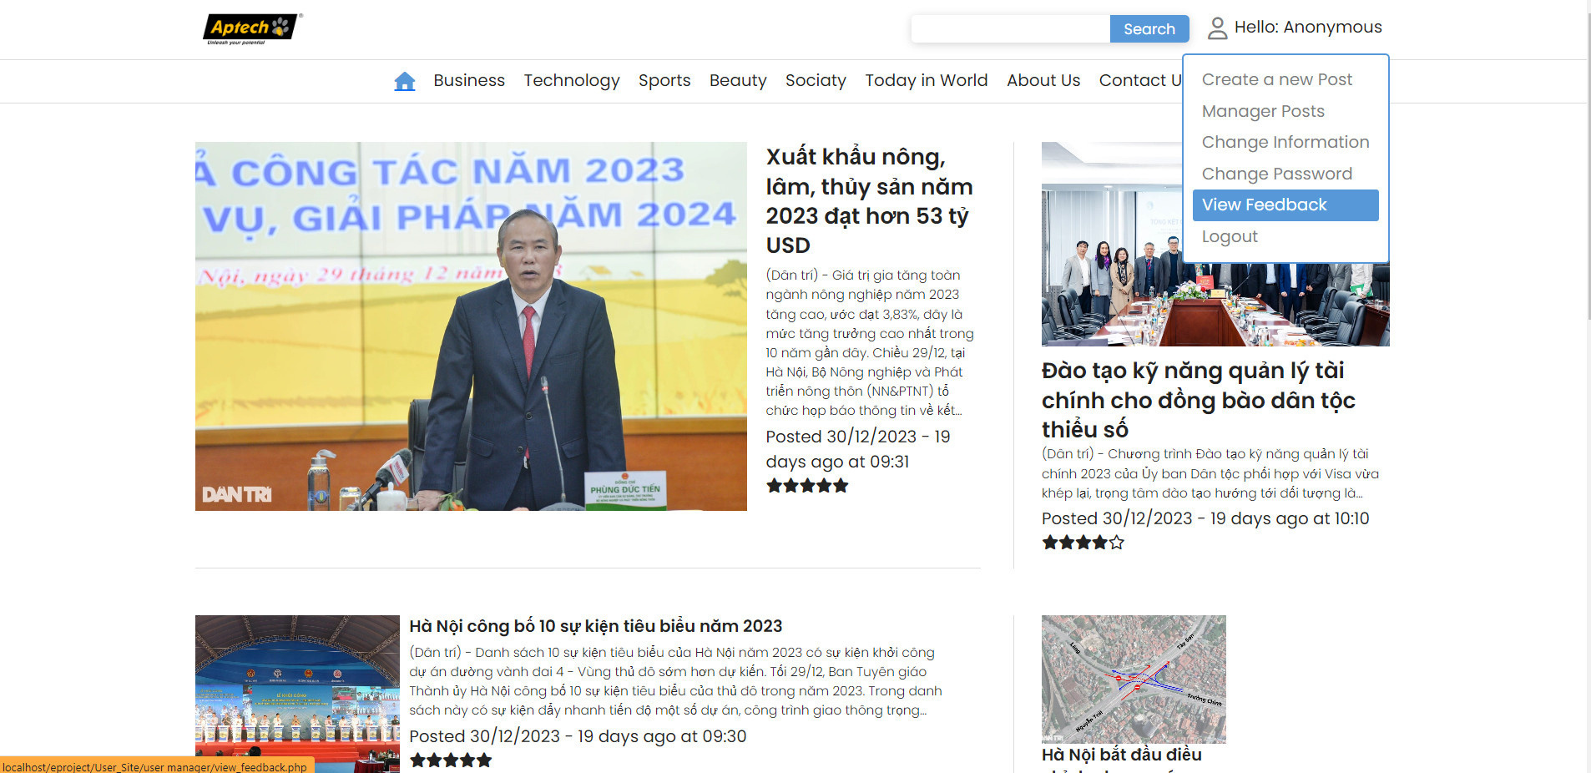
VIEW FEEDBACK

Slide 21
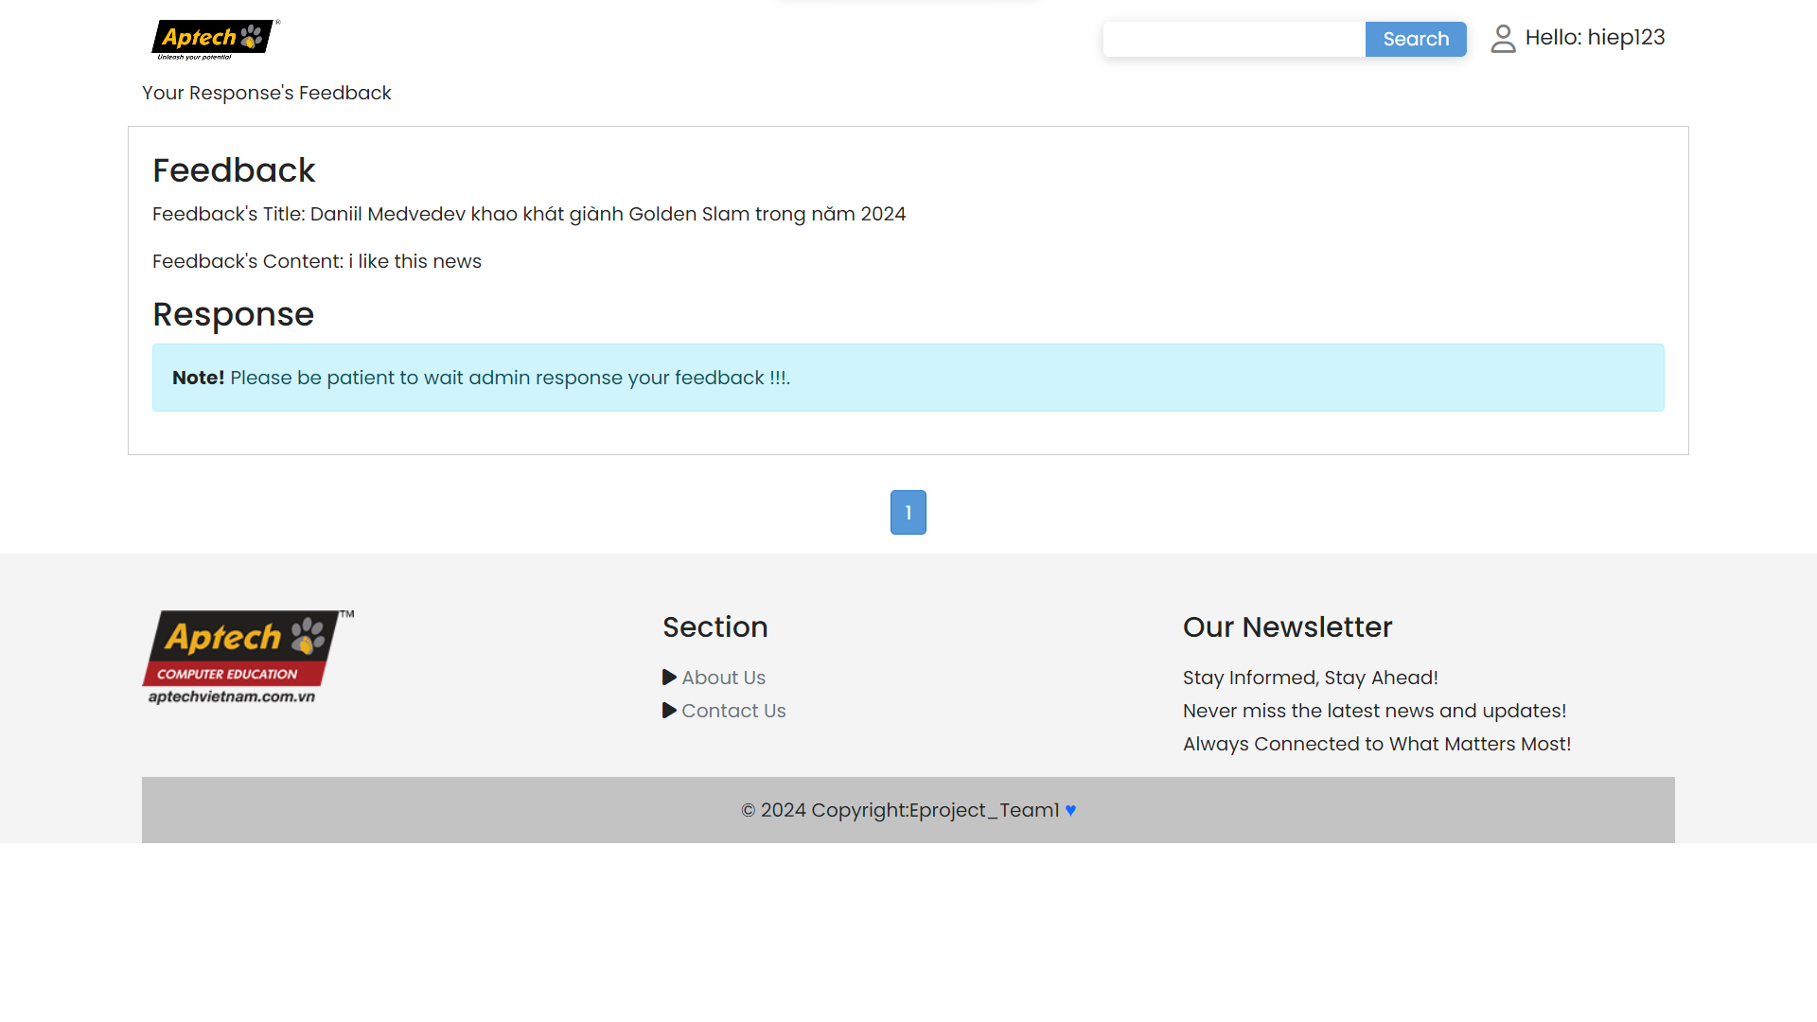
VIEW FEEBACK

Slide 22
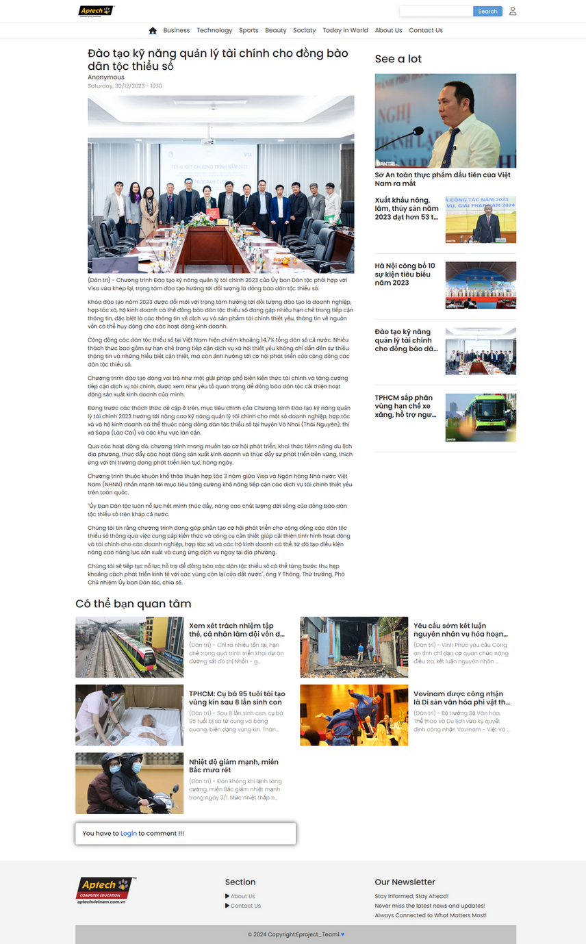
DETAIL PAGE
NEWS REPORTER
WEBSITE
INTERFACE
DESIGN

Slide 23

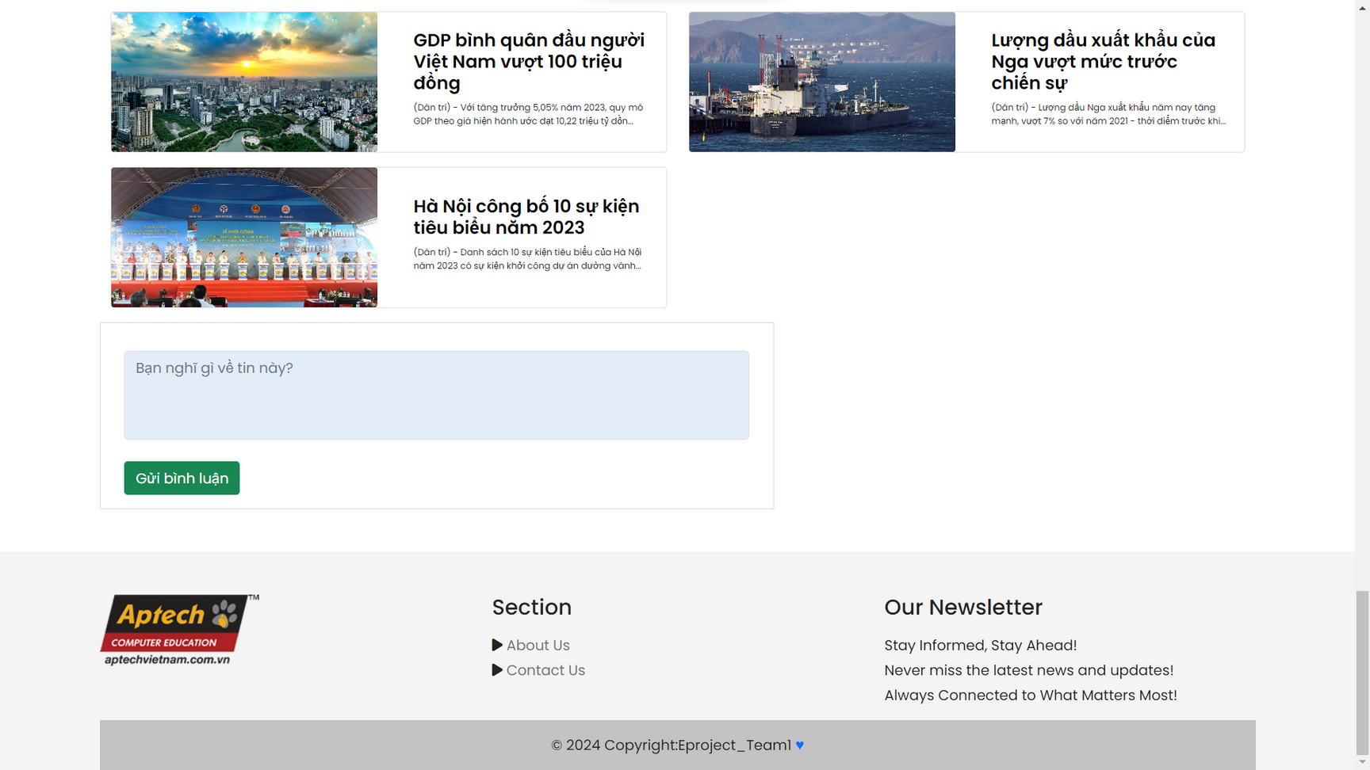

COMMENT

Slide 24
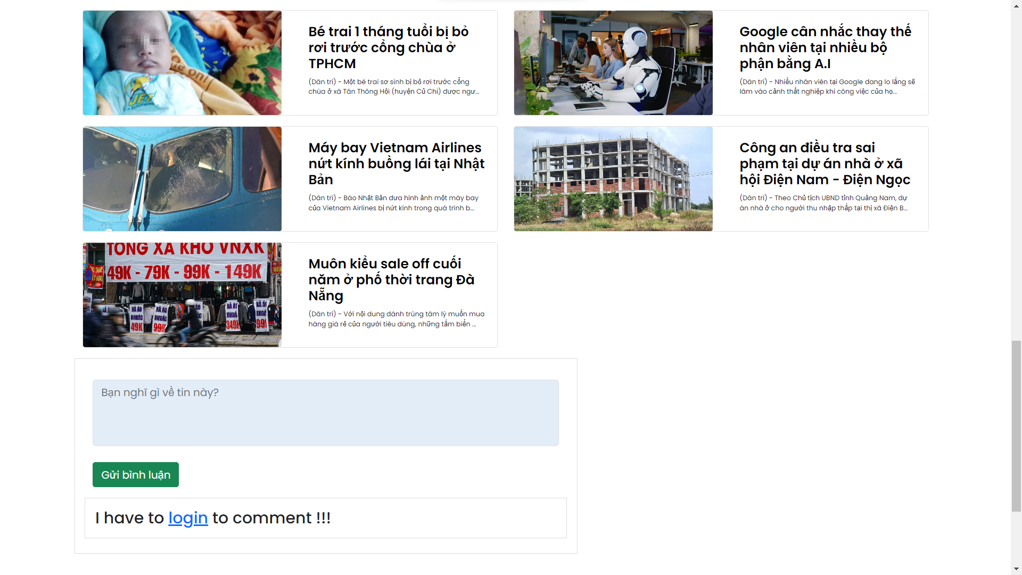
COMMENT

Slide 25

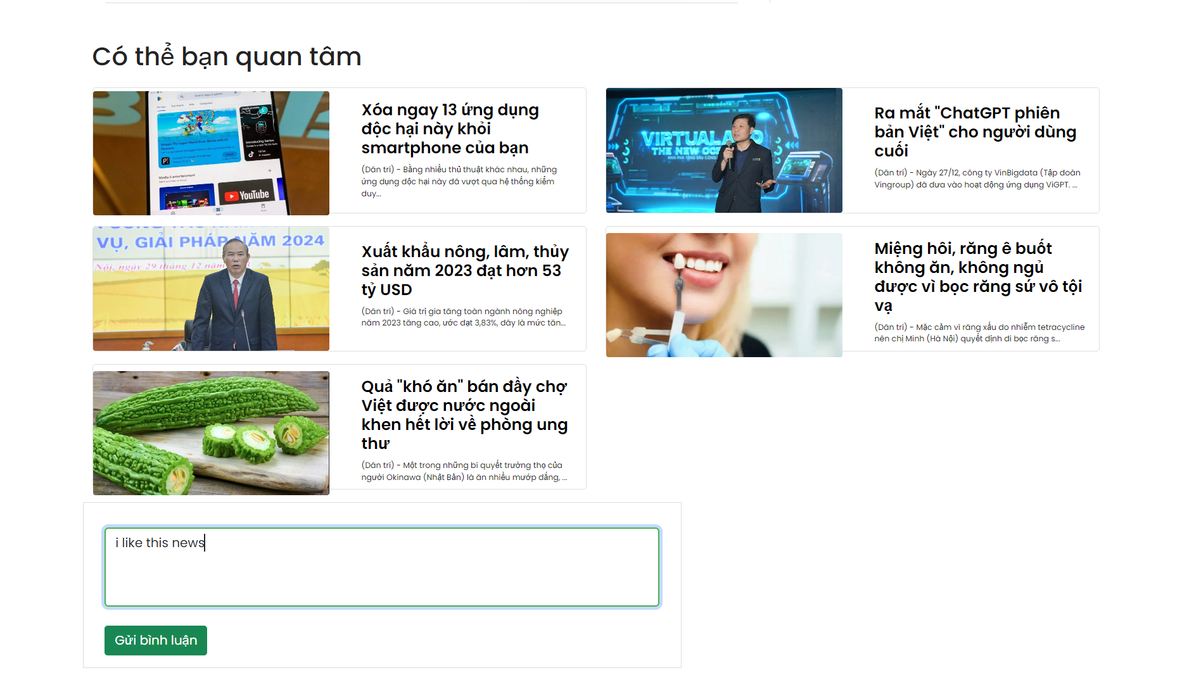
COMMENT

Slide 26

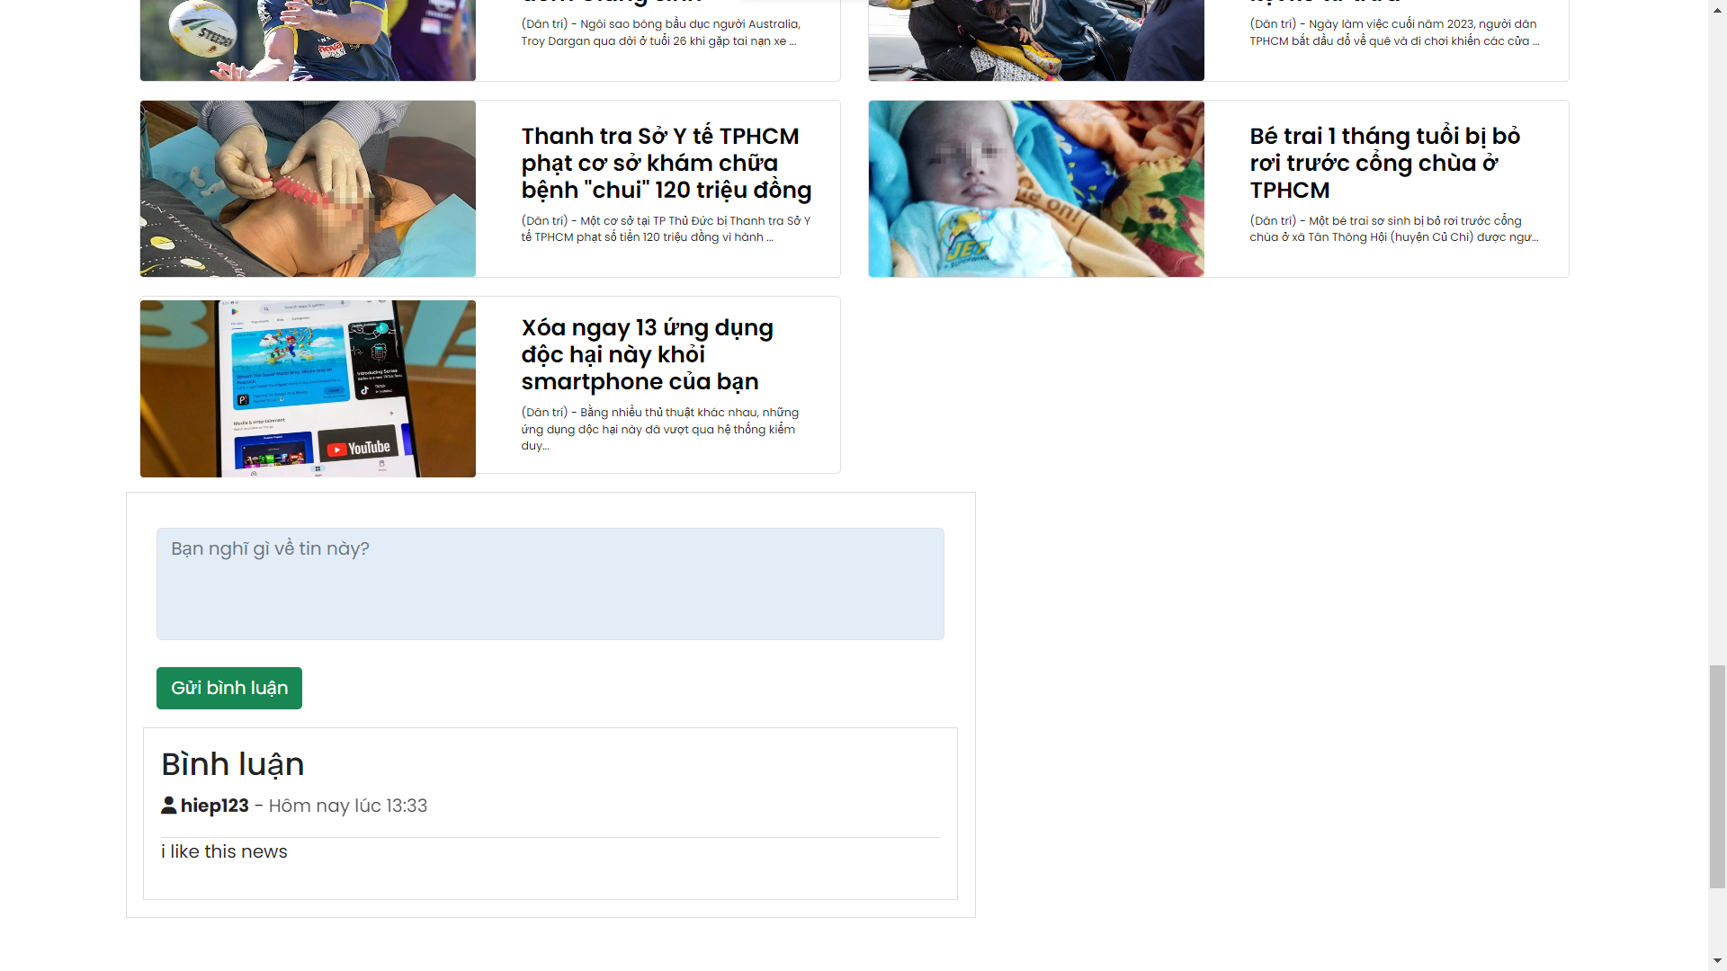
COMMENT

Slide 27
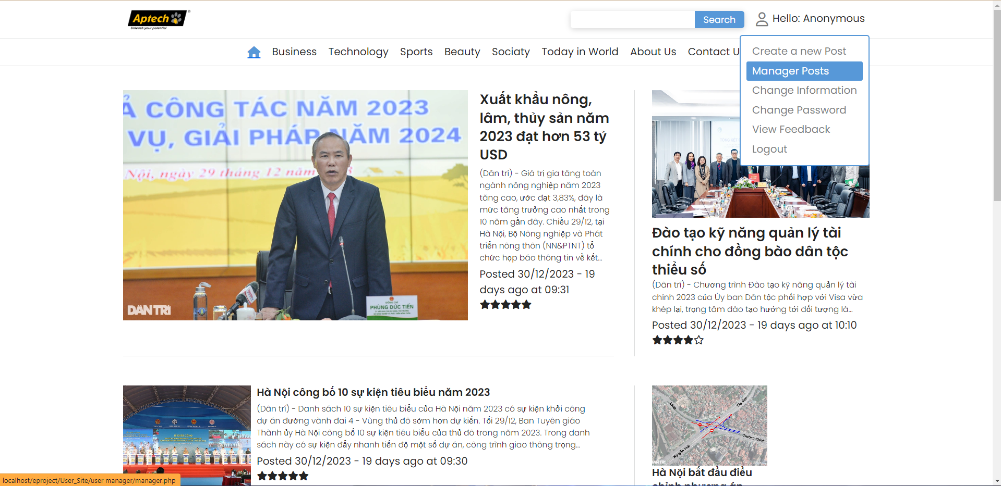
MANAGER POST

Slide 28

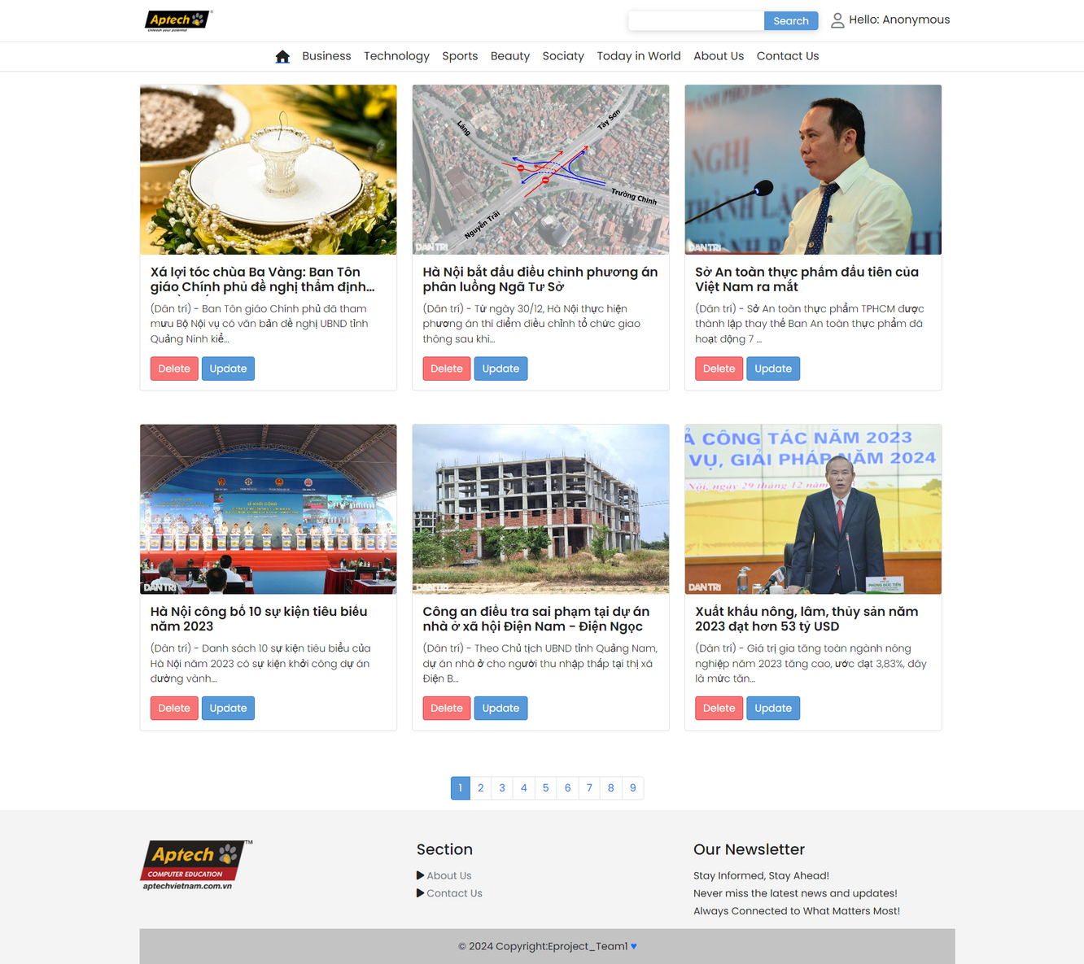
MANAGER POST

Slide 29
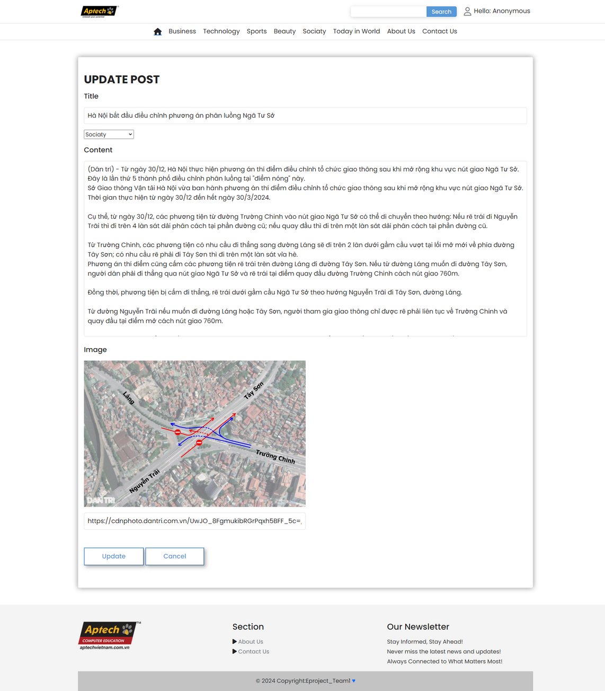
MANAGER POST

Slide 30

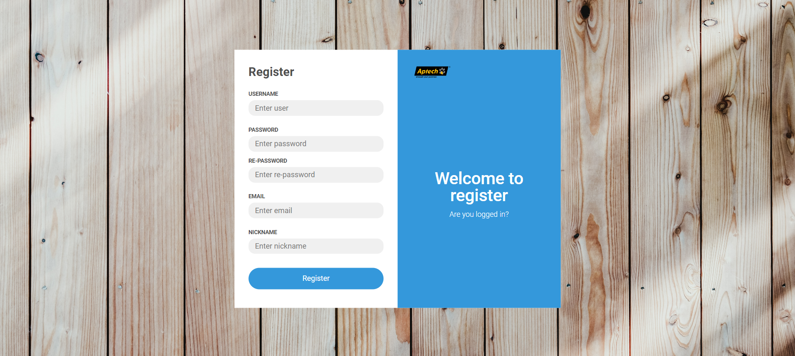
SIGN UP

Slide 31

SIGN UP

Slide 32
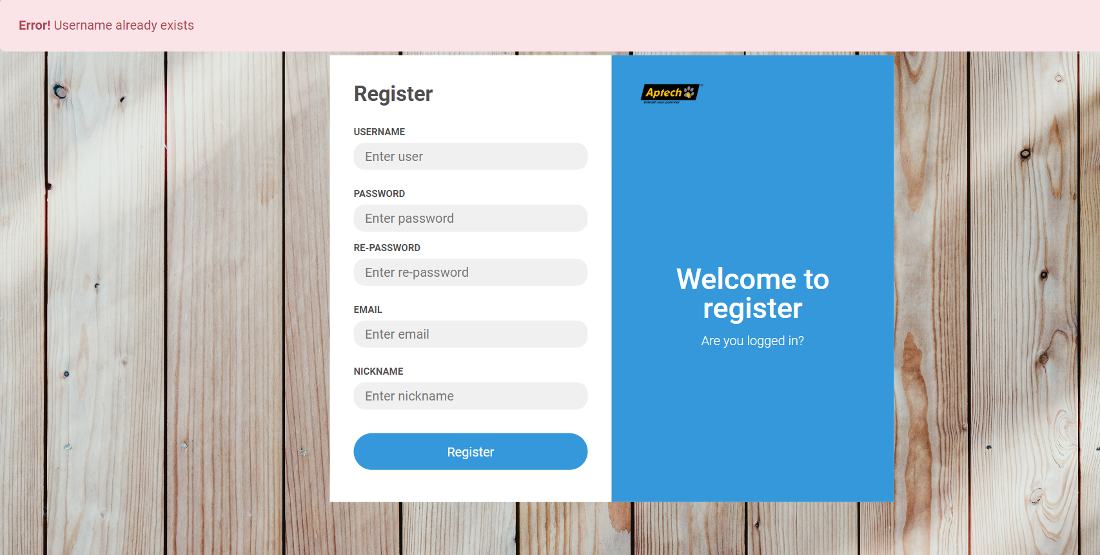
SIGN UP

Slide 33
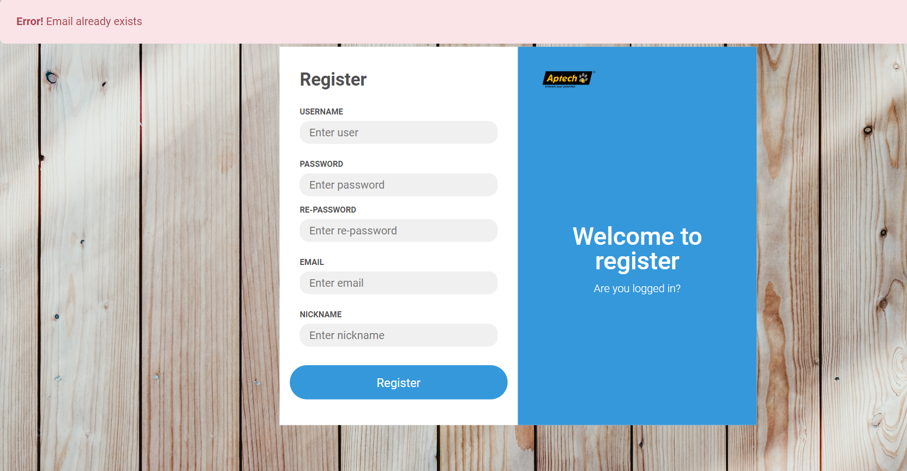
SIGN UP

Slide 34
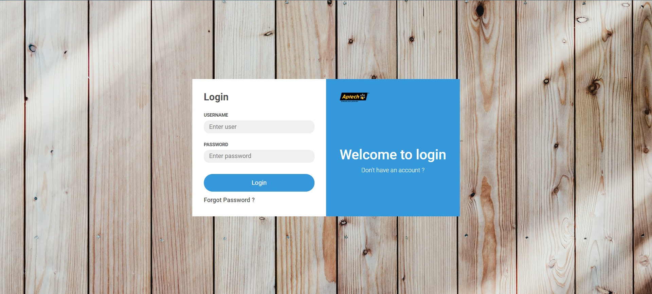
SIGN IN

Slide 35
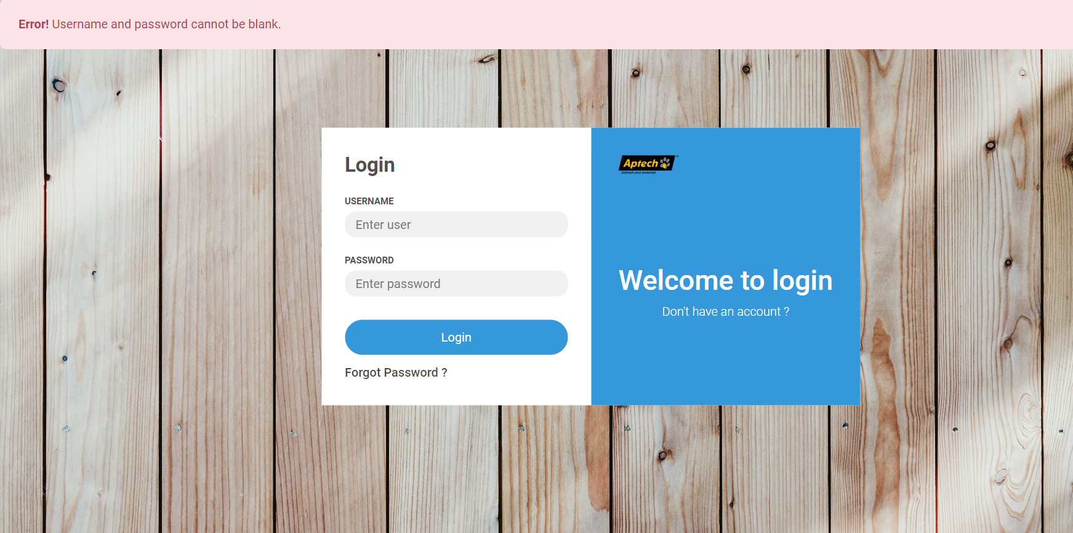
SIGN IN

Slide 36
Forgot Password

Slide 37

Forgot Password

Slide 38
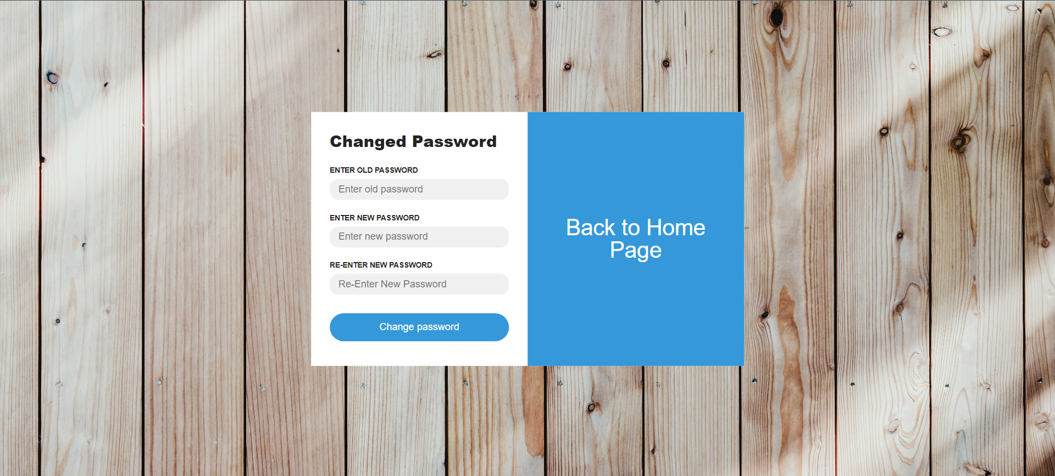
CHANGED PASSWORD

Slide 39

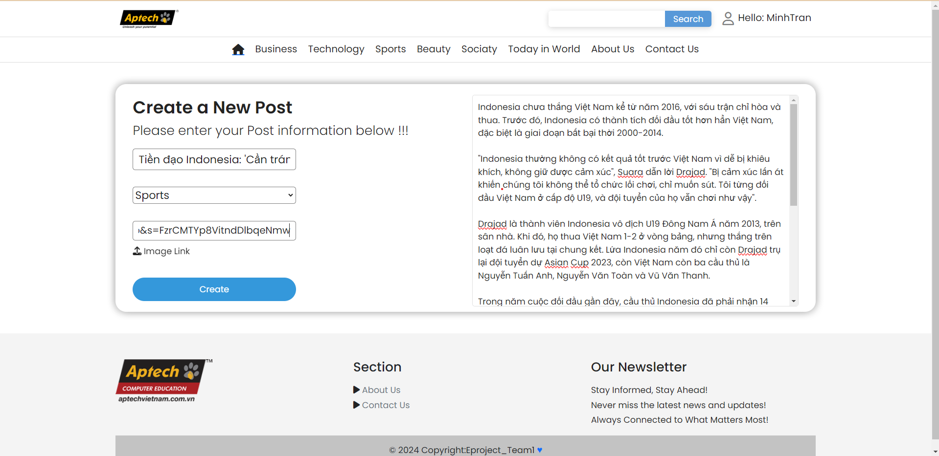
CREATE A NEW POST

Slide 40
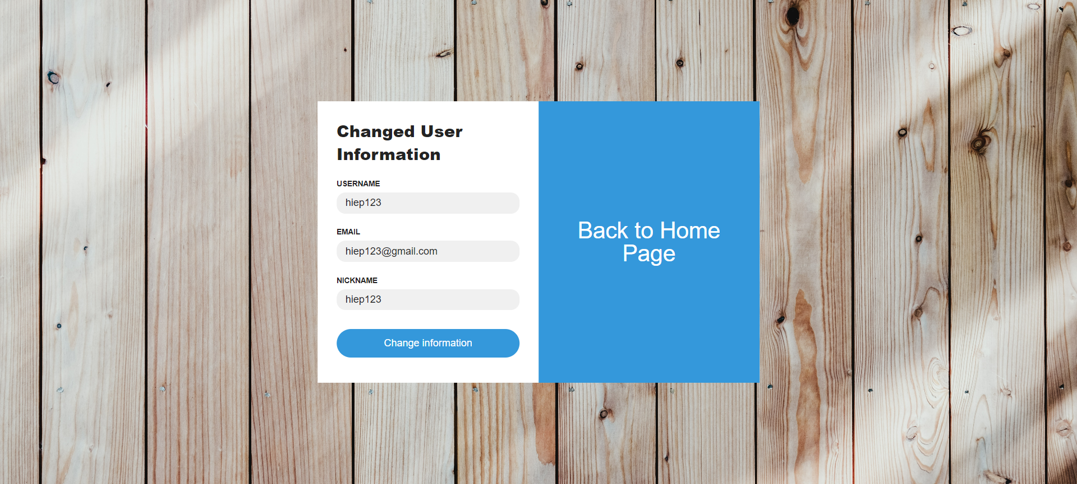
CHANGED USER INFORMATION

Slide 41
PAGINATION

Slide 42




THANK YOU VERY MUCH!

